Slide 1
QI Contact Tracing
Digital Twin and AI for safe re-entry Environment

Slide 2
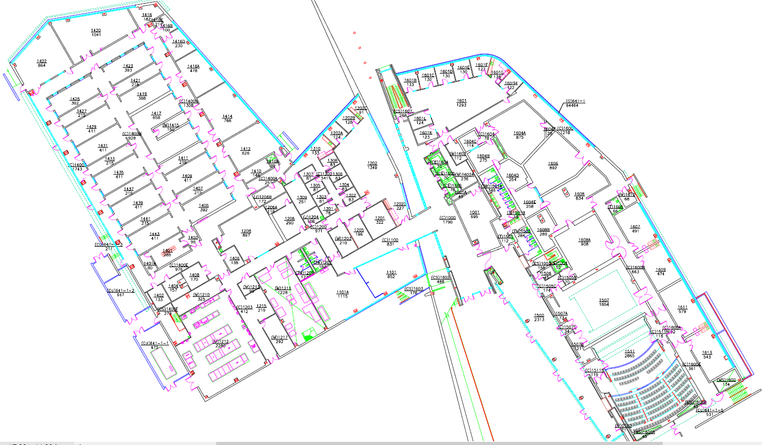
QI Building Map - 1st Floor Example

Slide 3

Graph Representation of the Rooms
In this smaller model, each room is connected to the closest room. In the larger model all rooms are potentially related - depending on the people visits to the rooms
Each node has latitude and longitude as properties, as well as a unique ID.

Slide 4
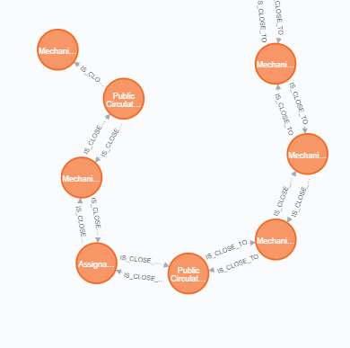
Graph Representation of the Rooms
Here is a close up of the graph shown before.
Each relationship has a distance property.
We can query for rooms within a certain distance of one node.

Slide 5
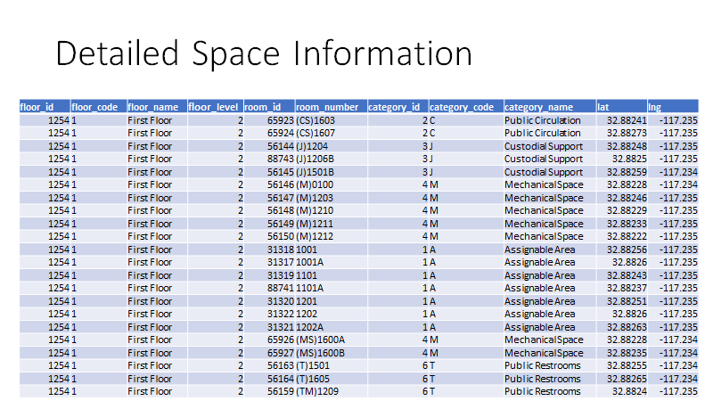

Slide 6
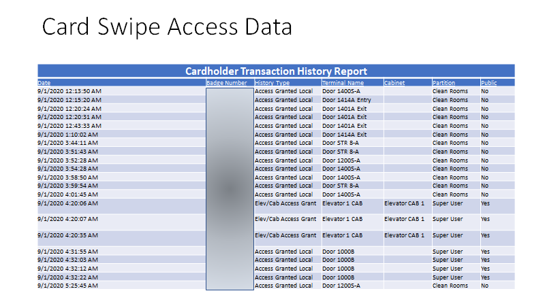

Slide 7
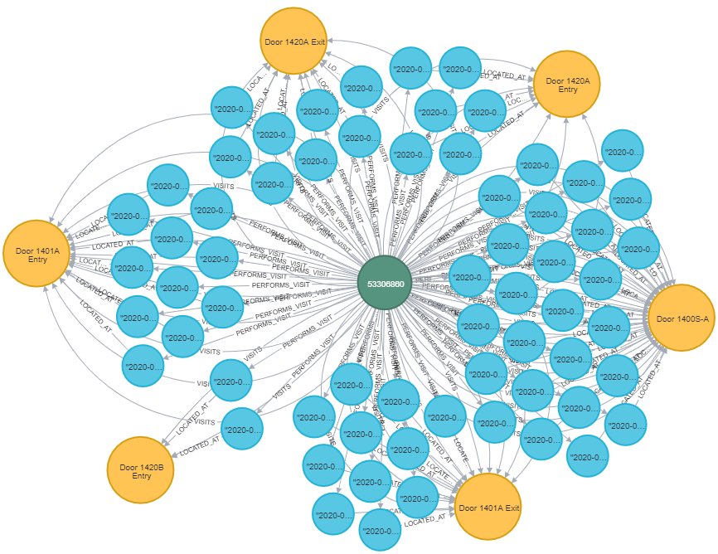
Card Swipe Visits Data Graph
Green: Badge ID (a person)
Blue: Visit nodes (with a start time property)
Yellow: Rooms (with sq. foot, type of room, etc. as properties
A person is connected to each visit node (representing all their visits), which in turn is connected to the room node.
People are also directly connected to the room nodes.

Slide 8
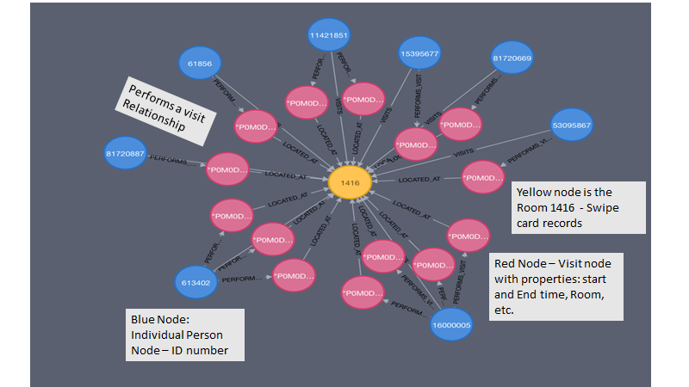

Slide 9
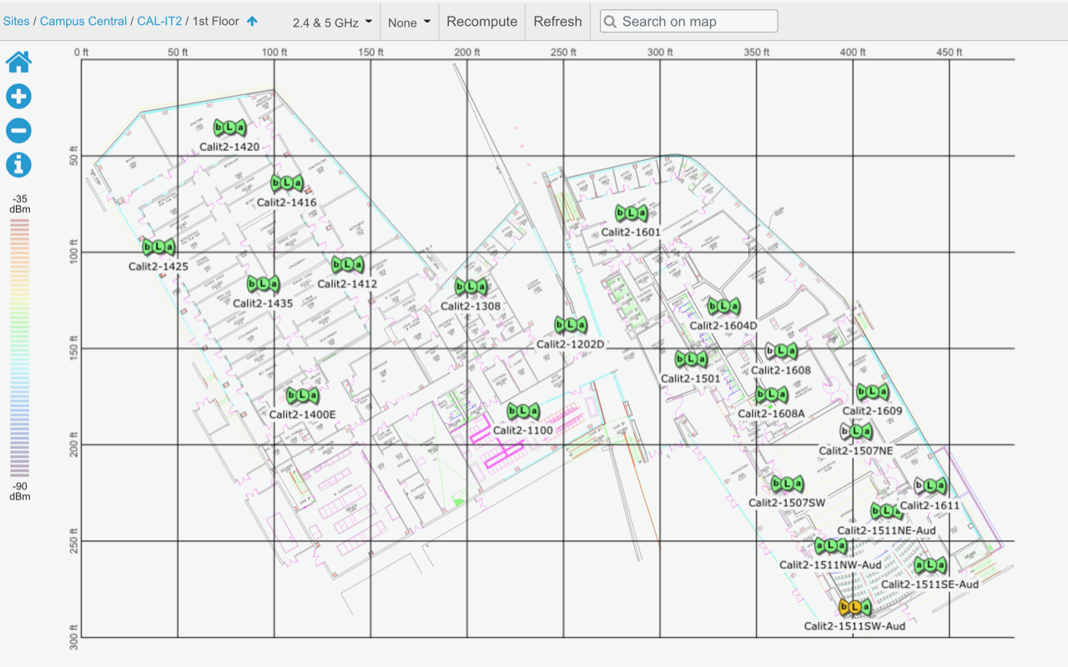
Wi-Fi Access Points Locations

Slide 10
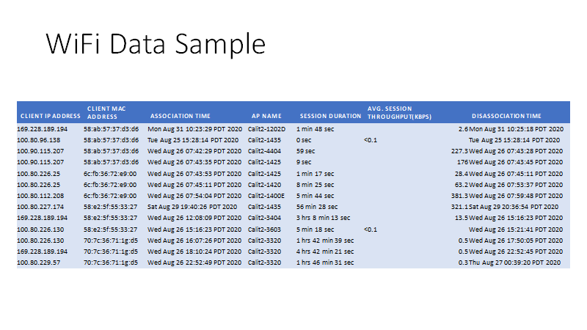

Slide 11
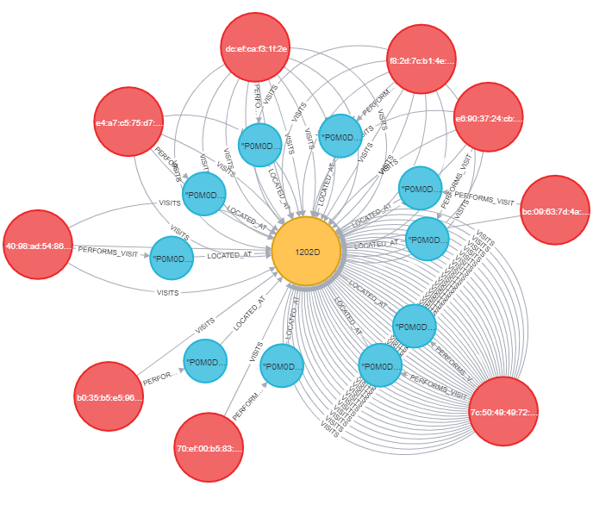
Graph Representation of the Visits (Wi-Fi)
Red: MAC addresses (individual devices)
Blue: Visit node (with properties including start time, end time, duration, etc.)
Yellow: Access point names
Follows the same template for relationships as the swipe data.

Slide 12
Overlap Query
Query checks for each visit in the selected group or person (A) with all other visits of everyone else (B). It uses the following logic: Max(starttime_A, starttime_B) <= Min(endtime_A, endtime_B). That is, the latest start time between the visit of person A and person B must occur before the earliest end time between those visits as well.
match (p:Person {id: "27901"})-[pv1:PERFORMS_VISIT]->(v1:Visit)-[vi1:VISITS]->(d:Door)<-[vi2:VISITS]-(v2:Visit)<-[pv2:PERFORMS_VISIT]-(p2:Person)
with p2, apoc.coll.max([v1.starttime.epochMillis,v2.starttime.epochMillis]) as maxStart, apoc.coll.min([v1.endtime.epochMillis,v2.endtime.epochMillis]) as minEnd
where maxStart <= minEnd
return p2.id, sum(minEnd-maxStart) as overlaptime
order by overlaptime desc

Slide 13
Network Query Discovering Overlapping Visits
Total overlap for a certain date and time between any one person and everyone else.
Can be extended to a group of people with a certain property (e.g. sick) and everyone else (e.g. healthy).
Duration of the overlap time and proximity of people can be prespecified
Card swipe data provides more accuracy but is limited to a smaller number of rooms
Wifi data limited to the nearest Wifi AP point - better availability

Slide 14
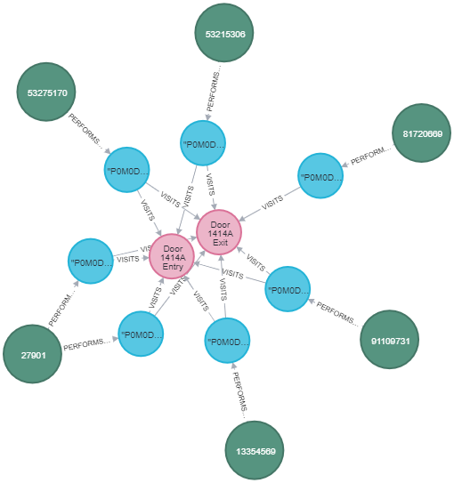
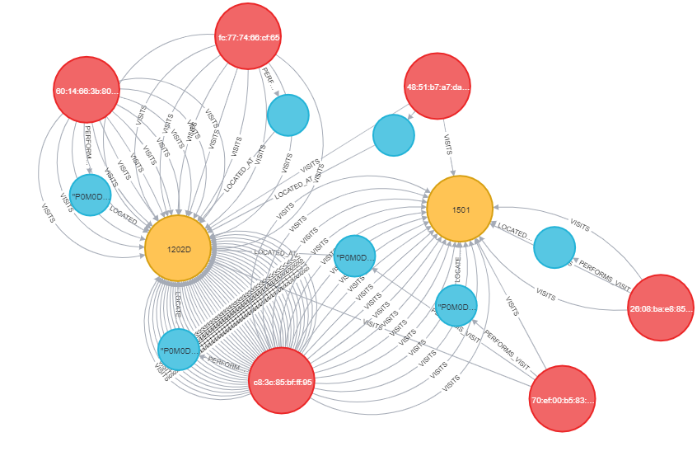
Visualization of Network Query for Overlapping Visits
Card Swipe Overlap
Wi-Fi Data Overlap

Slide 15
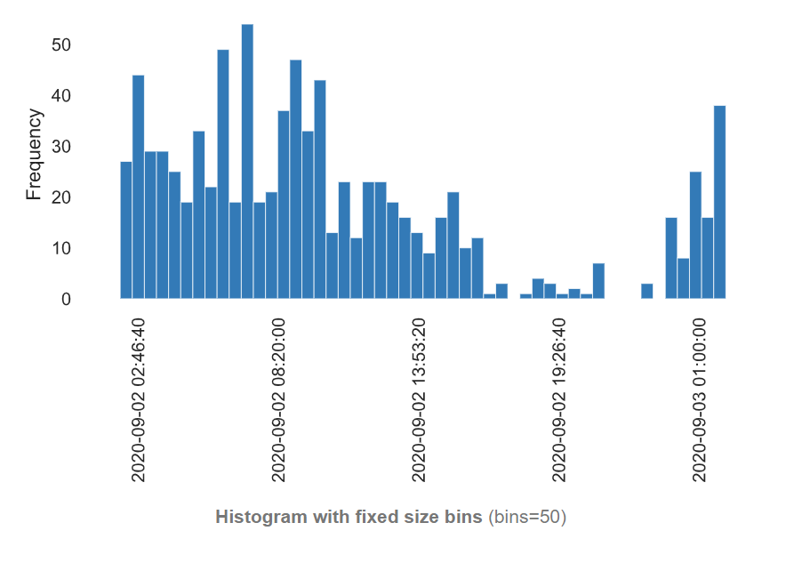
Cron Job versus Human
EDA on Swipe Card Data
Histogram of swipe card times for 1 day
Notes:
Overall we are in the process of building a binary classification model to determine if a mac address belongs to a human or a bot, and are looking into the overlap of swipe card and wifi data schedules and connection times, as well as other features to build this model. This will help us determine occupancy which is related to the risk of viral contact.

Slide 16
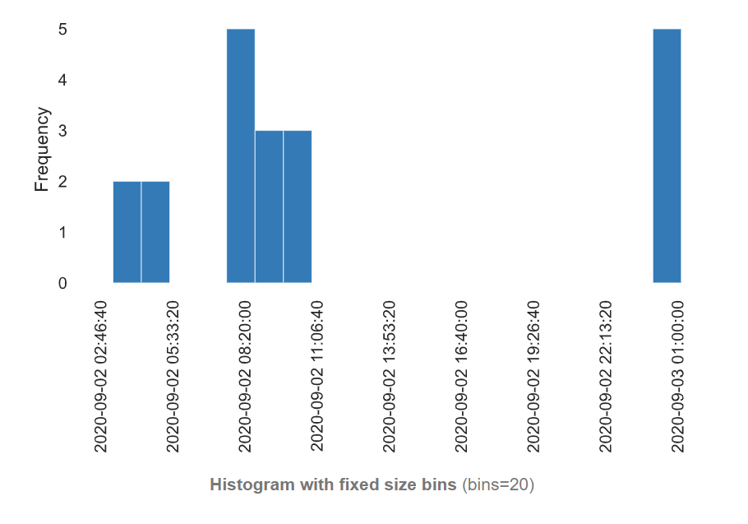
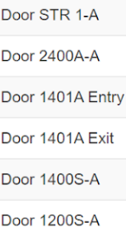
Random swipe ID: 81720895 Example
An employee who works night shifts, not a janitor (Access Granted Local), and had access to clean rooms.
Visited the following rooms to the left
Notes:
This is an example of a night shift worker. An employee who works night shifts, not a janitor (Access Granted Local), and had access to clean rooms.
Visited the following rooms to the left

Slide 17
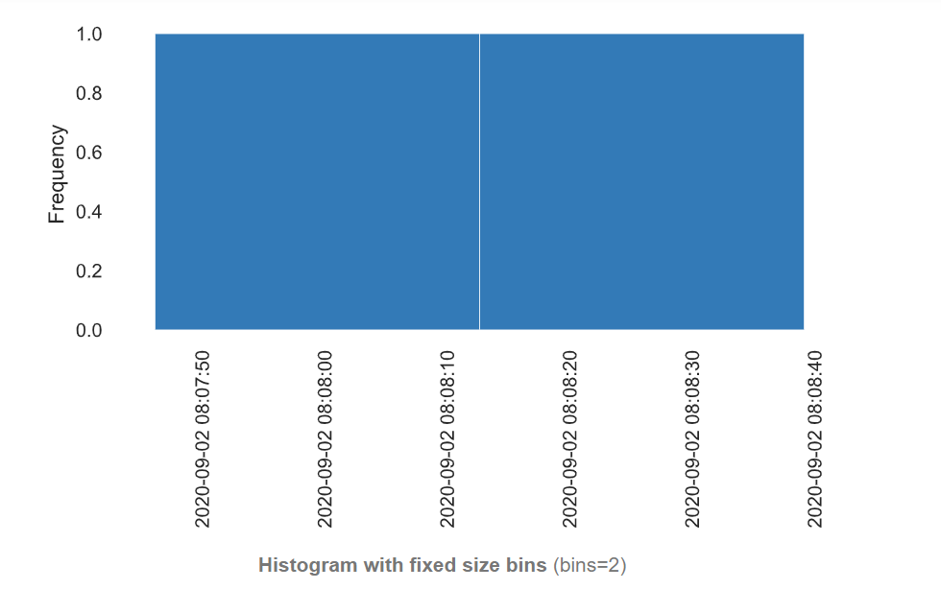
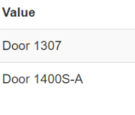
Random ID: 91109408
An employee who works day shift, access to clean rooms and super user partitions.
Visited the following rooms below:

Slide 18
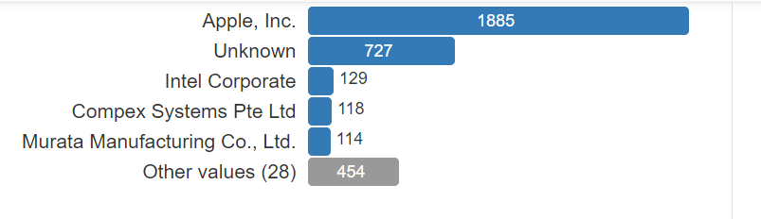
EDA for Vendor Data based on the User MAC Address Analysis
Significant number of devices with unknown MAC Addresses
=> possibility of manual switch to “Randomized MAC Address”
=> possible distinction between Human and Cron Job

Slide 19
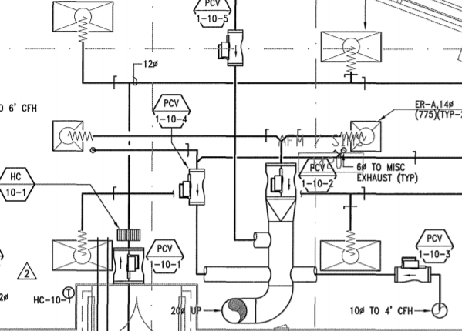
HVAC Plans and COVID Simulations
Utilizing digital twin to account and plan for emergency evacuation eg. Biohazard situation
Examine how humans behave to warnings to update plans
Simulating the movement of air particles with CO2 emission devices and HVAC structures

